Slide 1
Module: Web Development Foundations
Module Project
Design, Develop, Implement & Document Web Application
Huỳnh Minh Phú
PGSE0823
Start Date: | 18.3.2024 | End Date: | 18.3.2024
Submission Date: | 23.3.2024 | Presentation Date: | <insert date>

Slide 2
Content
S. No. | Description
01 | Project Background & Objective
02 | Software Development Methodology
03 | Project Plan
04 | Feasibility Study
05 | Development Tools
06 | Business Process
07 | Application Block Diagram
08 | Applications
09 | Models, Controllers & Classes Developed
10 | UI Design
11 | Includes & Dependencies
12 | Errors and Debugging
13 | Application Screen Shots
14 | Project Milestones & Tasks

Slide 3
Content
S. No. | Description
15 | Milestone Feedback & Action Taken
16 | Modifications Made On Feedback
17 | Project Results
18 | Proposed Improvements
19 | References

Slide 4
Project Background & Objective
The primary objective of the project is to design and develop a feature-rich web application that caters to the diverse needs of Educlass stakeholders. The application will facilitate efficient management of educational resources, provide interactive learning tools, and foster seamless communication among students, teachers, and administrators.
Key Objectives:
Enhanced User Experience
Interactive Learning Tools
Effective Communication
Scalability and Reliability
Security and Data Privacy
Performance Optimization

Slide 5
Project Plan
Initiation: Define project scope, objectives, and stakeholders.
Planning: Develop a detailed project plan with tasks, timelines, and resources.
Execution: Implement the project plan, monitor progress, and manage resources.
Monitoring and Controlling: Track project performance and address any issues or risks.
Closure: Review project deliverables and transition the product to operations.

Slide 6
Feasibility Study
Key Components:
Technical Feasibility: Evaluate the technical requirements, resources, and expertise needed to develop and implement Educlass.
Economic Feasibility: Analyze the cost-benefit ratio, return on investment, and financial viability of the project.
Operational Feasibility: Assess the impact of Educlass on existing processes, workflows, and stakeholders.
Findings:
Technical Feasibility: The project is technically feasible, with the required expertise and resources available.
Economic Feasibility: The cost-benefit analysis indicates a positive return on investment, making the project economically feasible.
Operational Feasibility: Educlass aligns with existing processes and workflows, enhancing operational efficiency.

Slide 7
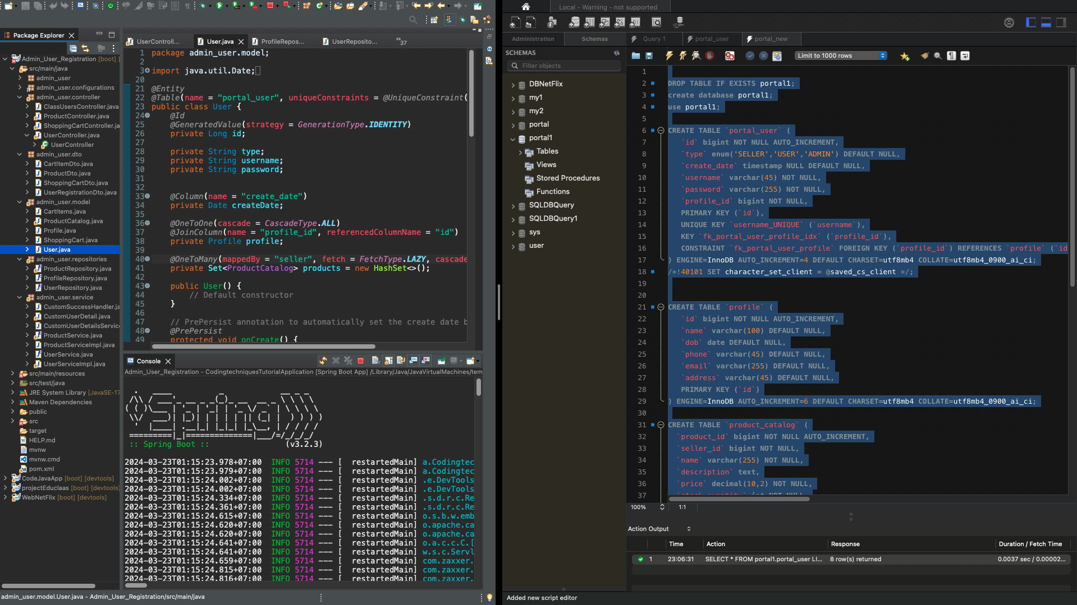
Development Tools
Screenshot of development tools and Snippets of work within the tools’ interface

Slide 8
Business Process
Block Diagram of Various Business Process
Procurement
Product Development
Sales & Marketing
Customer service

Slide 9
Application Block Diagram
Block Diagram of the Overall Application
User Interface
Business Logic
Data Access Layer
Database

Slide 10
Application
Description of components or modules being developed
1. User Interface (UI) Module
Goal: Ensure intuitive and seamless user interaction.
Highlight: Responsive design adaptable to various devices.
2. Authentication & Authorization
Goal: Secure user access and protect data integrity.
Highlight: Implements multi-factor authentication and role-based access.
3. Business Logic
Goal: The nucleus of the application, processing core functions and rules.
Highlight: Robust data validation and algorithmic processing for optimal performance.
4. Data Access Layer (DAL)
Goal: Efficient data management between the business logic and database.
Highlight: Optimized CRUD operations and data caching for speed.

Slide 11
Application
Description of components or modules being developed
5. Database
Goal: Secure and structured data storage.
Highlight: Ensures data integrity and supports complex queries.
6. APIs and Integration
Goal: Facilitate communication with external systems and services.
Highlight: Flexible RESTful APIs and seamless third-party integrations.
7. Analytics and Reporting
Goal: Offer actionable insights through data analysis.
Highlight: Real-time visualization and customizable reporting tools.

Slide 12
Models, Controllers, Classes
Overview of Models, Controllers & Any Classes Developed
Models
User Model: Manages user data, authentication, and authorization details.
Product Model: Handles product information, inventory status, and pricing.
Order Model: Tracks order details, statuses, and payment information.
Controllers
User Controller: Facilitates user registration, login, and profile management.
Product Controller: Manages product listings, updates, and deletions.
Order Controller: Oversees order creation, updates, and history.

Slide 13
Models, Controllers, Classes
Overview of Models, Controllers & Any Classes Developed
Utility Classes
Email Service: Sends automated emails for notifications and password resets.
Payment Processor: Integrates with payment gateways for secure transactions.
Data Validator: Ensures data integrity and validation across the application.
Key Highlights
Separation of Concerns: Clear distinction between logic layers for better maintainability.
Reusability: Utility classes designed for reuse across different parts of the application.
Scalability: Modular design allows for easy expansion and integration of new features.

Slide 14
Classes - Entities
S. No. | Class Name | Description
1 | User | - Represents an individual user of the application. - Methods include login, logout, and account management functionalities.
2 | Profile | - Extends the User entity with additional personal information. - Methods include profile update and data retrieval functionalities. Product
3 | Product | - Represents items available for purchase within the application. - Methods include product management functionalities like add, update, and delete.
4 | Cartitem | - Represents a single item within a shopping cart. - Methods include quantity update and price calculation functionalities.
… | Shoppingcart | - Represents a user's shopping cart containing multiple CartItems. - Methods include add item, remove item, and total price calculation functionalities.

Slide 15
Classes Developed
S. No. | Class Name | Description
1 | ClassUsersController.java | - Manages operations related to user classes or groups. - Facilitates the creation, modification, and deletion of user groups. - Handles requests for viewing all members within a class and their respective roles.
2 | ProductController.java | - Oversees all product-related functionalities. - Enables the addition, update, and removal of products from the catalog. - Handles requests for product information, including descriptions, pricing, and availability.
3 | ShoppingCartController.java | - Manages the shopping cart operations. - Allows users to add, update, or remove items from their shopping cart. - Calculates the total cost of items in the cart and handles checkout processes.
4 | UserController.java | - Responsible for user account management. - Handles user registration, authentication, and profile updates. - Provides functionalities for password management and account settings.
This is an example that there are still many other classes that help the system operate

Slide 16
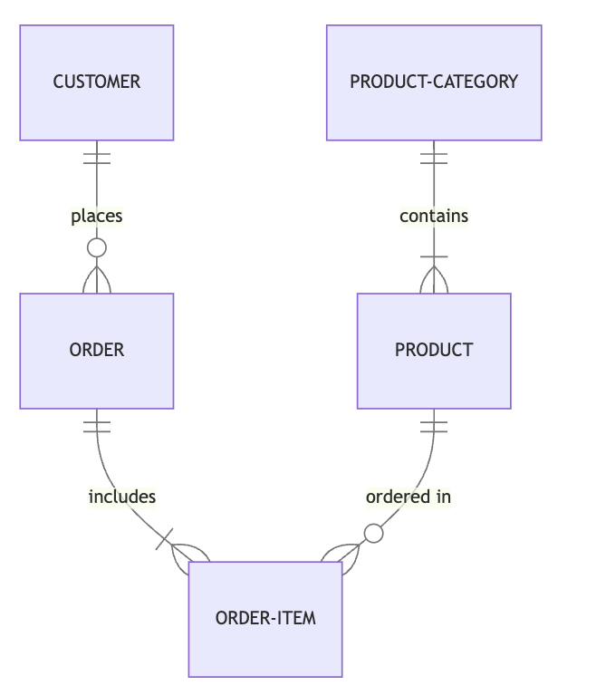
Database Design
ER Diagram & Physical Design Developed

Slide 17
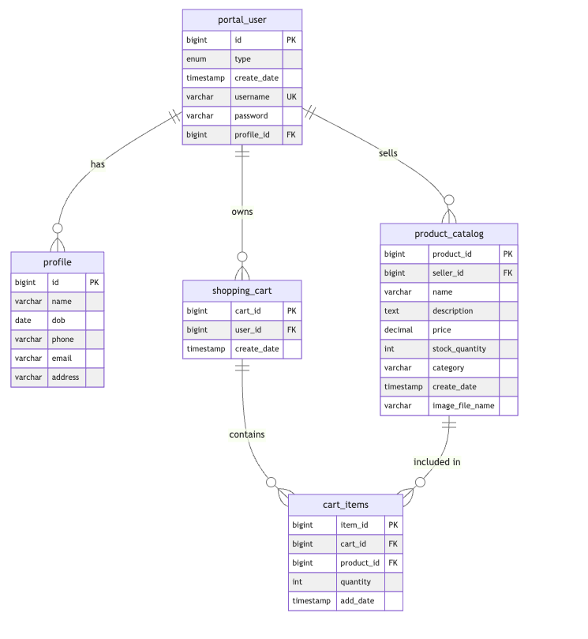
Database Design

Slide 18
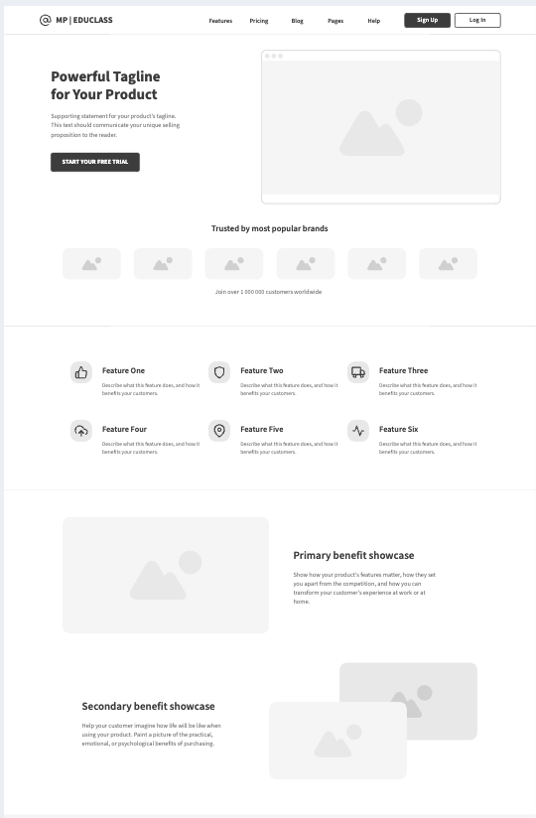
UI Design

Slide 19
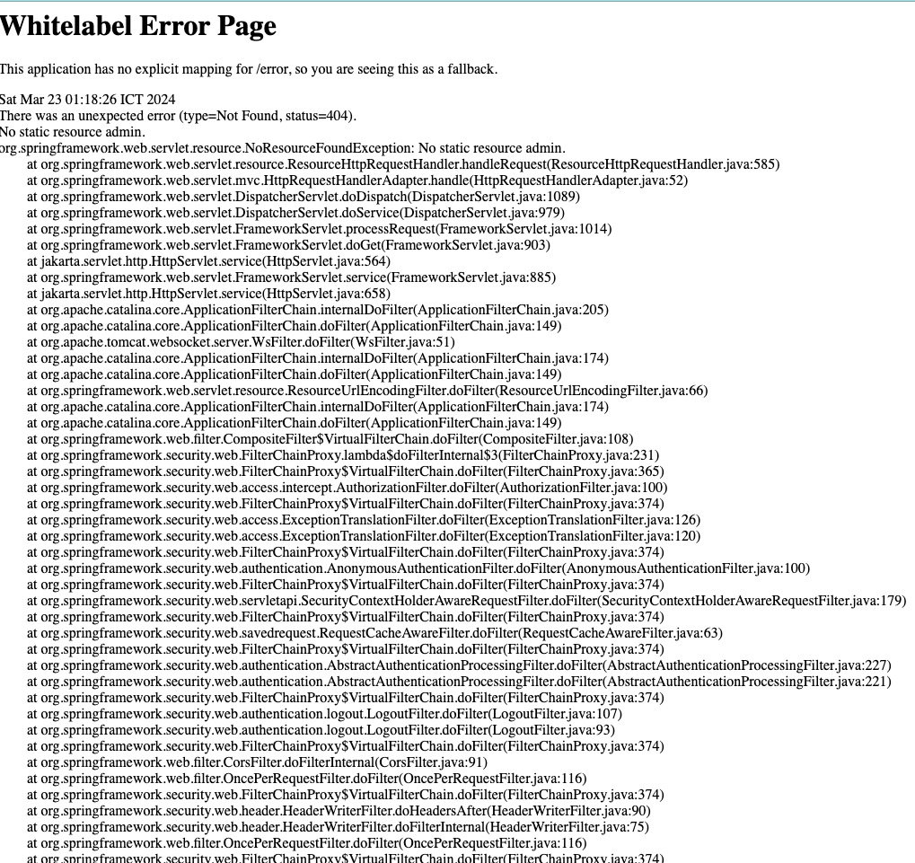
Errors and Debugging
Explain 3 errors and how it was debugged

Slide 20
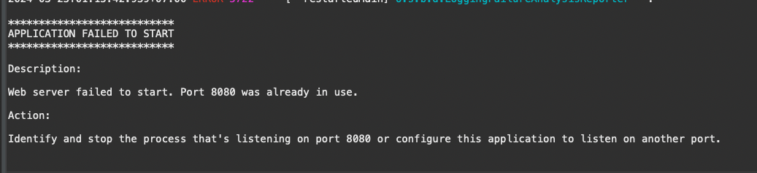
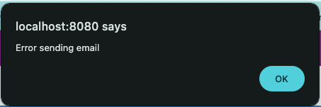
Errors and Debugging
Explain 3 errors and how it was debugged
Solution: Use Google, stackoverflow, Consult or ask for support from teachers - Teacher, Teacher Giau, Teacher Tu

Slide 21
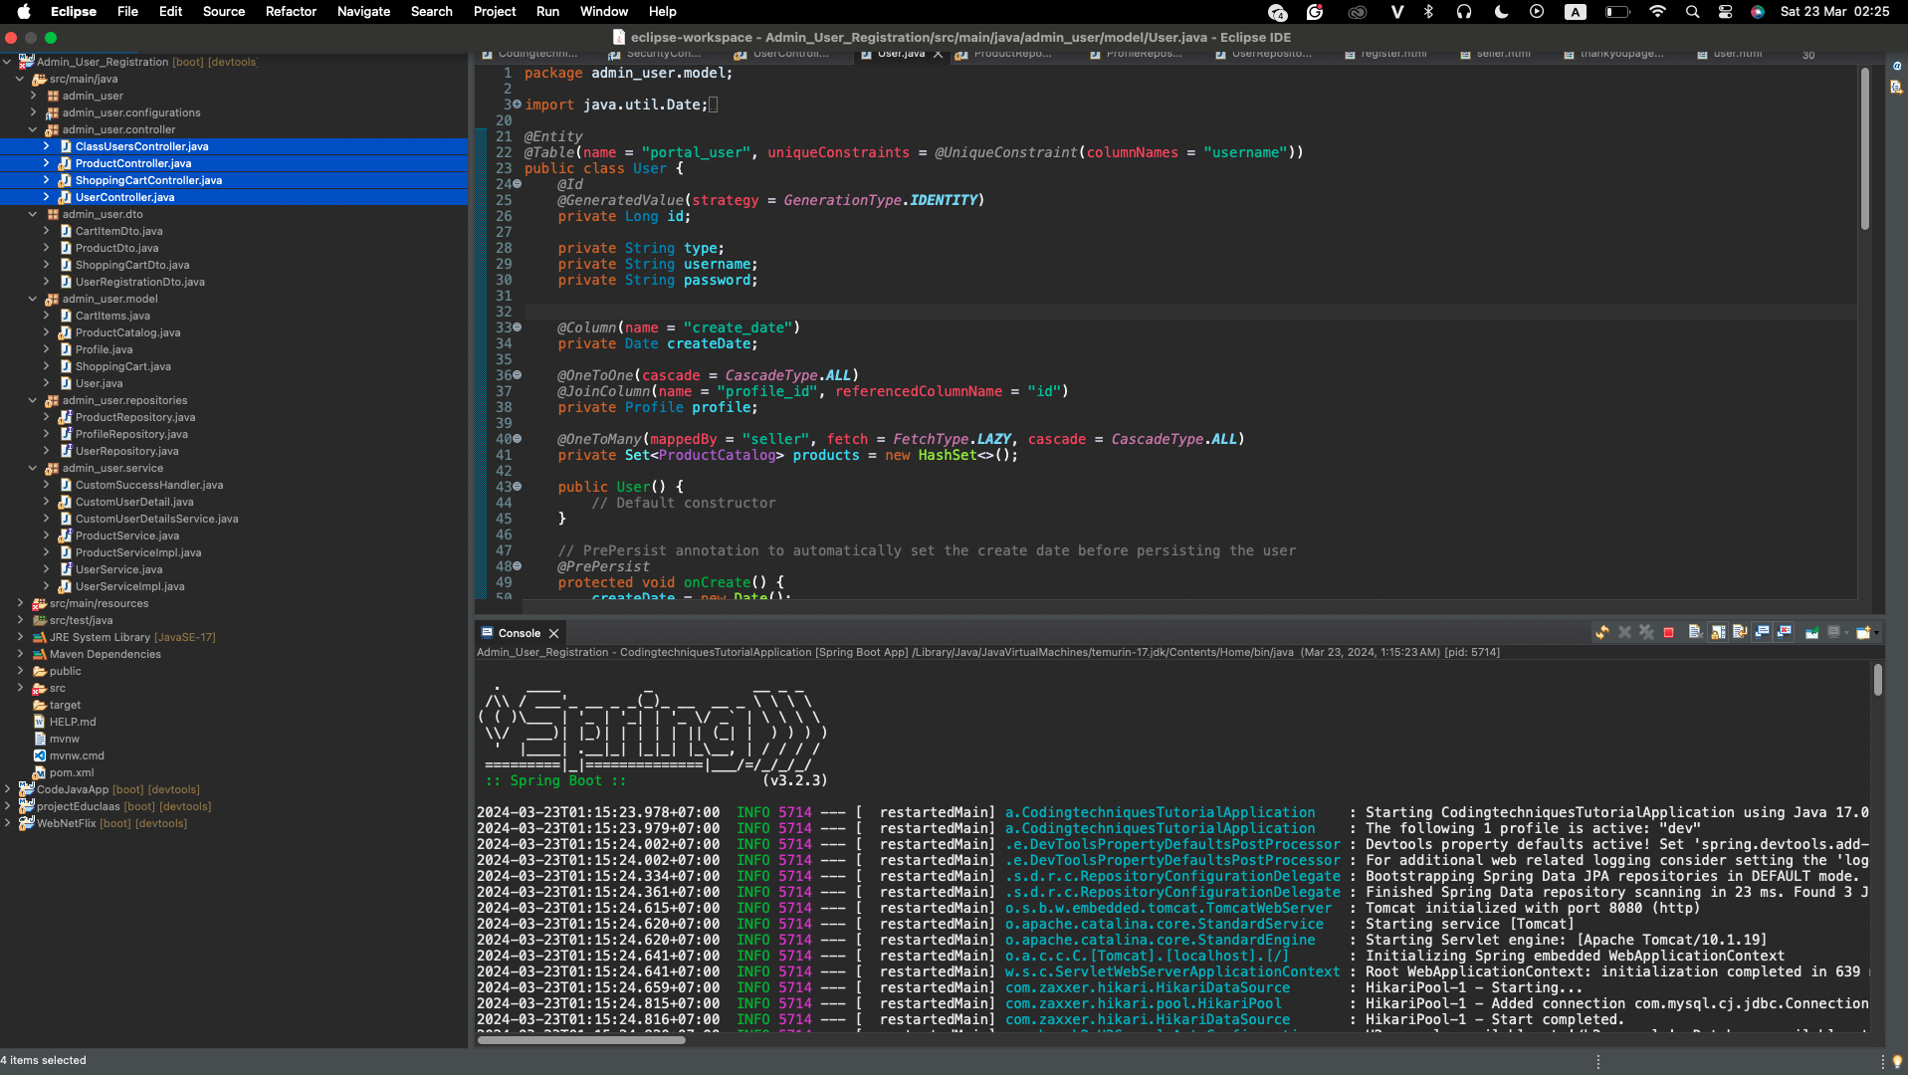
Application Screenshots

Slide 22
Project Milestones & Tasks (1 of 2)
Project Task ID | Project Major Task Description | Project Milestone ID
1 | Setup the Development Environment based on the Technical Development Environment | 1
2 | Power point Detailing the Business Process in the Proposed Application | 1
3 | Project Report detailing the Technical Design | 1
4 | Power Point Detailing the Project Plan | 1
5 | Develop the UI HTML standard pages (Based on Module 3 work) | 2
6 | Create common Struts Includes, Models, Views & Controllers | 2
7 | Develop Classes | 2

Slide 23
Project Milestones & Tasks (2 of 2)
Project Task ID | Project Major Task Description | Project Milestone ID
8 | Develop Struts Application | 2
9 | Develop Test Cases | 3
10 | Develop Project Documentation | 3
11 | Develop User Manual | 3

Slide 24
Milestone Feedback & Action taken
Project Milestone ID | Milestone Feedback received from Tutor / Learning Facilitator | Action Taken (Yes / No)
1
 | Feedback on the design approach, including the choice of technologies, architecture, and user interface design. | Yes
2 | Problem-Solving: Assessing the ability to troubleshoot and solve problems encountered during development. | Yes
3 | Documentation: Reviewing the completeness and clarity of the project documentation. | Yes

Slide 25
Modifications Made based On Feedback
1. Easily find documents to develop projects.
2. Solve problems faster and know how to handle them better
3. Recommend reputable and quality document sources

Slide 26
Project Results
Solved more than 80% of project requirements
There are still a few faulty functions but it doesn't affect the project quality too much.

Slide 27
Proposed Improvements
User-Friendly Interface: The chat widget is designed for ease of use, ensuring users can access support effortlessly.
Instant Support: Real-time messaging enables immediate assistance, improving user satisfaction.
Prompt Notifications: Support staff are quickly notified of new chats, ensuring efficient response times.
Accessible Chat History: Users and staff can reference past conversations, enhancing the quality of support.

Slide 28
References
Youtube.com
Stackoverflow.com
spring.io
https://getbootstrap.com/
https://howkteam.vn/

Slide 29
THANK YOU

